Slide 1
Arkansas’s Birds: A Dynamic Community
Dan Scheiman, Ph.D.
Bird Conservation Director

Slide 2
State List – 419 species

Slide 3
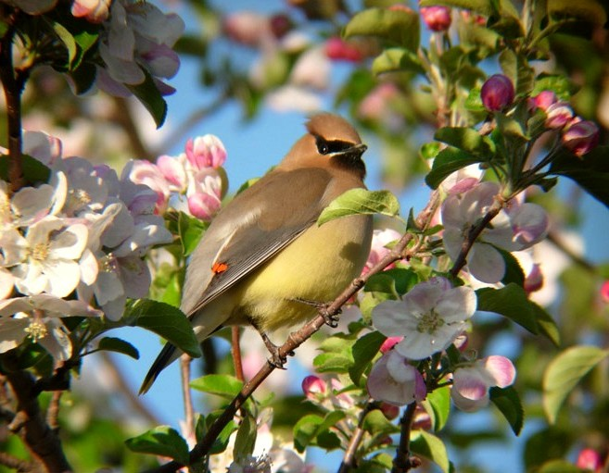
Overview
Dynamic
Geography
Habitat
Season
Movement
Cedar Waxwing
R. Brady

Slide 6
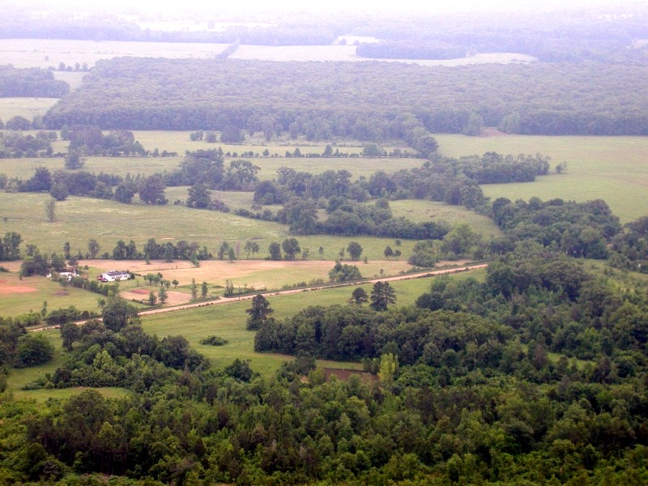
Habitat
Types
Woodland
Grassland
Shrubland
Wetland
Open water
Farmland
Urban
Generalist vs. Specialist

Slide 8
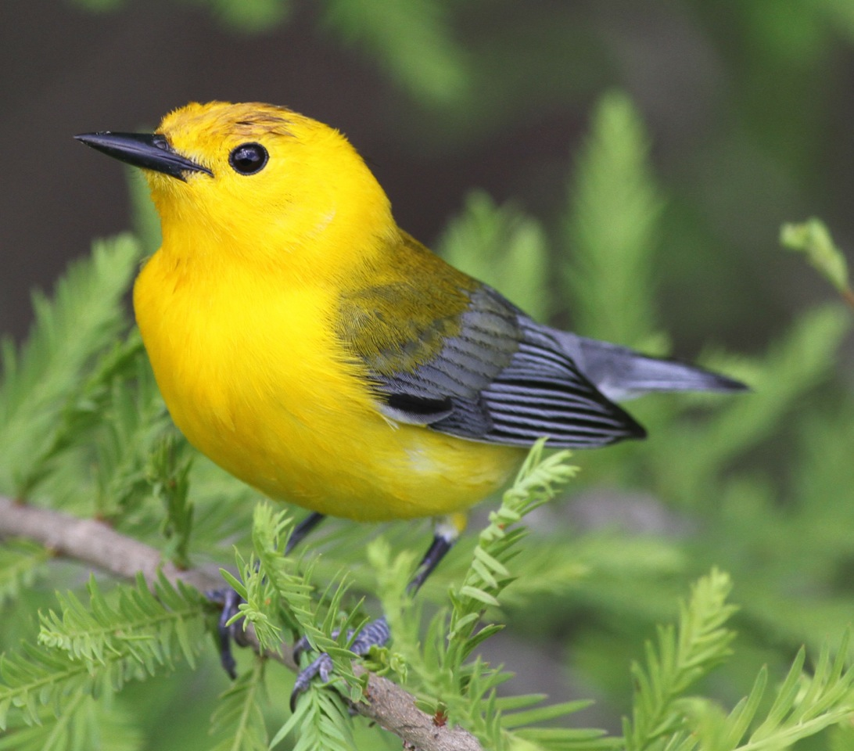
Prothonotary Warbler
J. Redman

Slide 9
Prothonotary Warbler
N. Anich

Slide 10
Swainson’s Warbler
N. Anich

Slide 11
Swainson’s Warbler
N. Anich

Slide 13
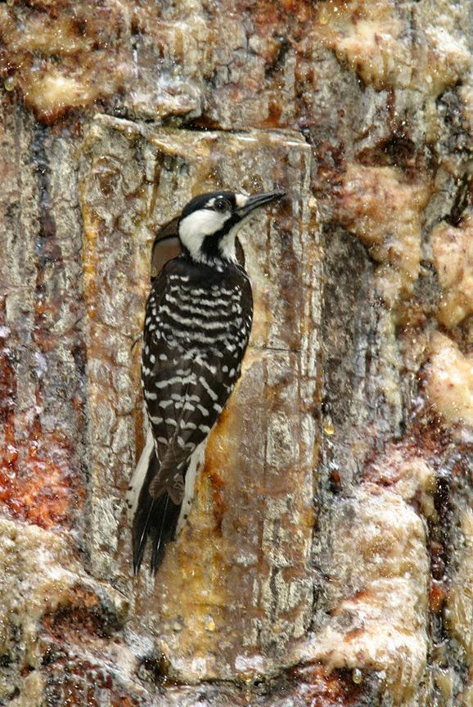
Red-cockaded Woodpecker
D. Elsen

Slide 14
Brown-headed Nuthatch
R. Herron

Slide 16
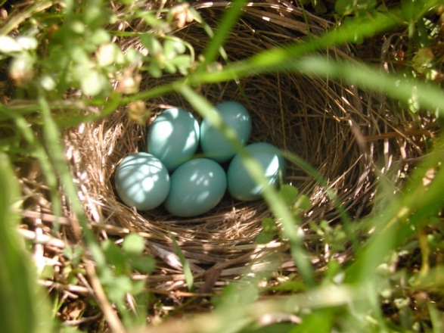
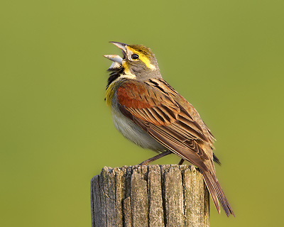
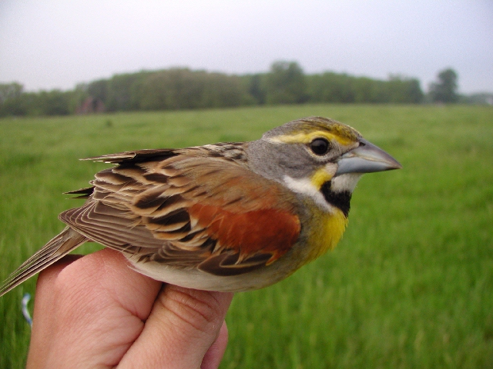
Dickcissel
D. Scheiman
C. Mills

Slide 17
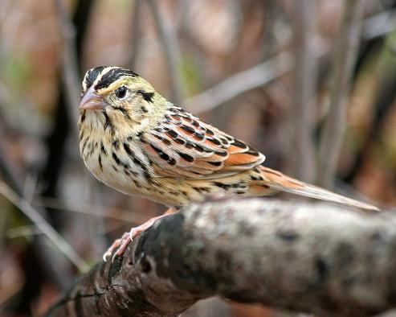
Henslow’s Sparrow
D. Provost

Slide 19
Indigo Bunting
R. Brady
L. Jernigan

Slide 20
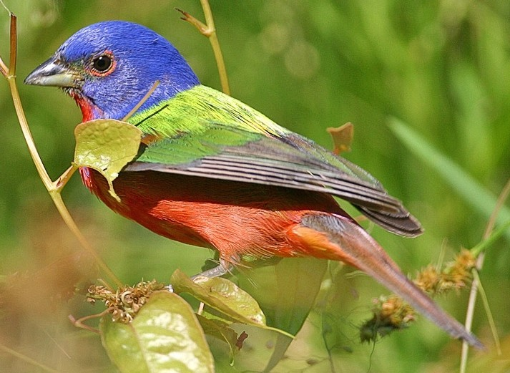
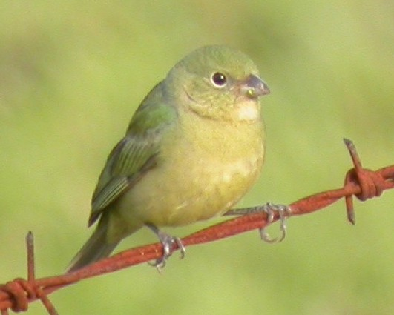
Painted Bunting
C. Mills
J. Neal

Slide 22
American Bittern
N. Anich

Slide 23
Marsh Wren
D. Herr

Slide 25
American White Pelican
R. Brady

Slide 26
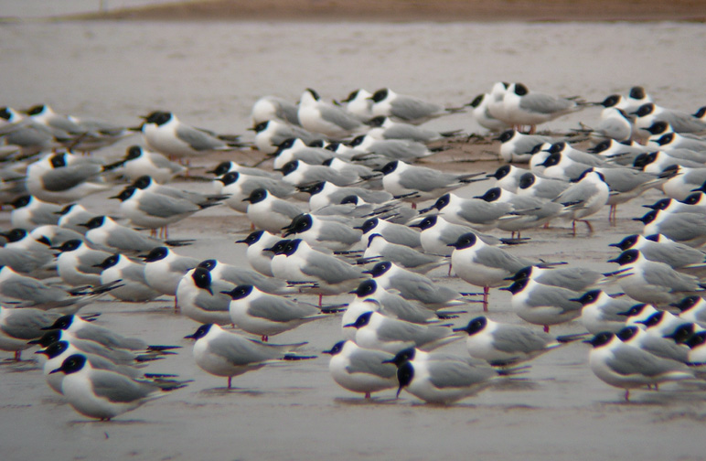
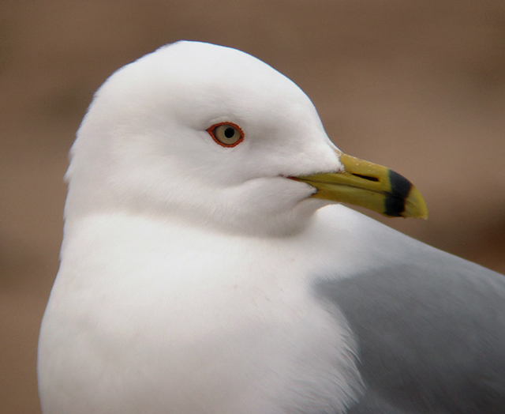
Gulls & Terns
R. Brady
Least Tern
Bonaparte’s Gull
R. Brady
Laughing Gull
Ring-billed Gull
N. Anich
R. Brady

Slide 28
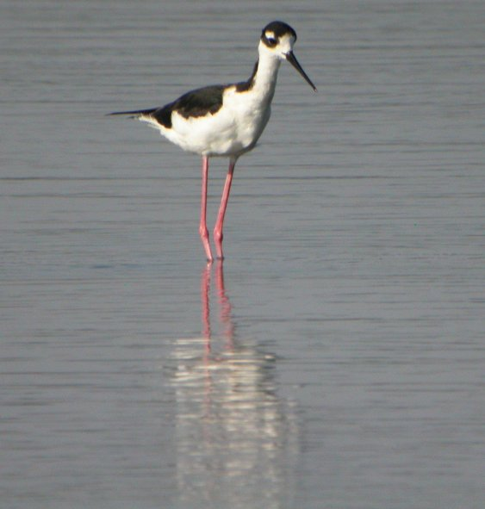
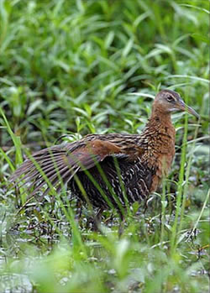
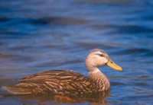
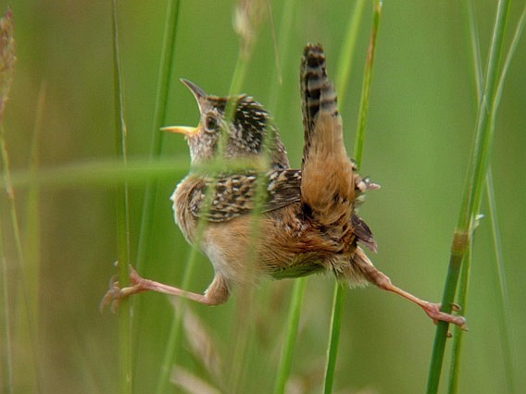
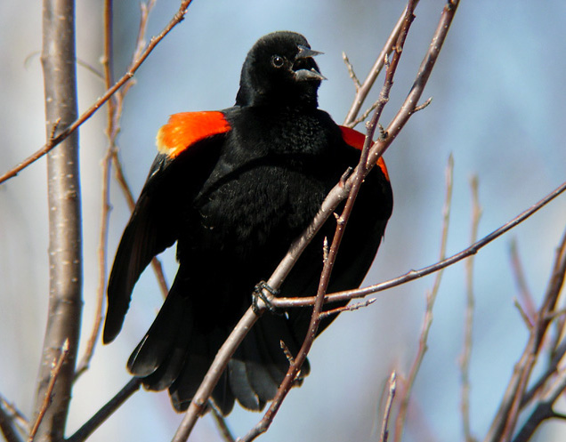
Rice Birds
N. Anich
C. Mills
Mottled Duck
C. Sowards
Black-necked Stilt
King Rail
Sedge Wren
R. Brady
R. Brady
Red-winged Blackbird

Slide 29
Horned Lark
R. Herron

Slide 31
Peregrine Falcon
D. Herr

Slide 32
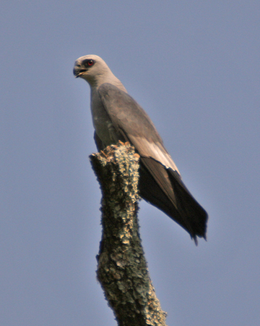
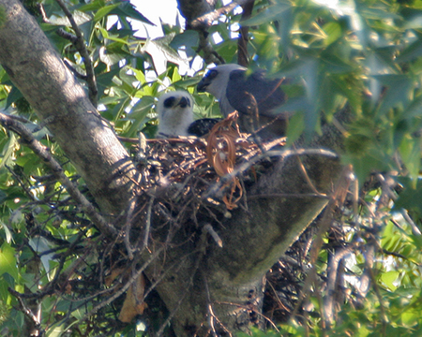
Mississippi Kite
R. Herron
N. Anich

Slide 33
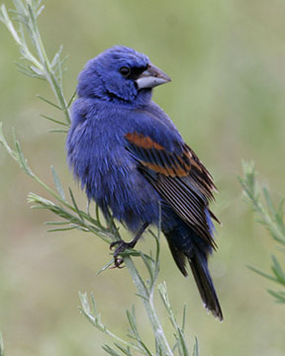
Seasons
Permanent
Breeding
Wintering
Migration
Spring
Fall
Blue Grosbeak
R. Herron

Slide 34
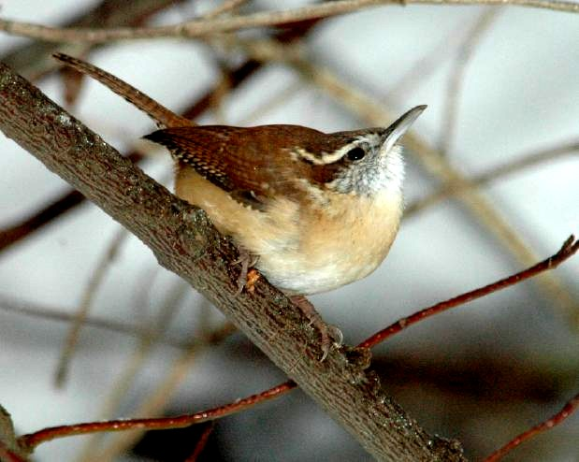
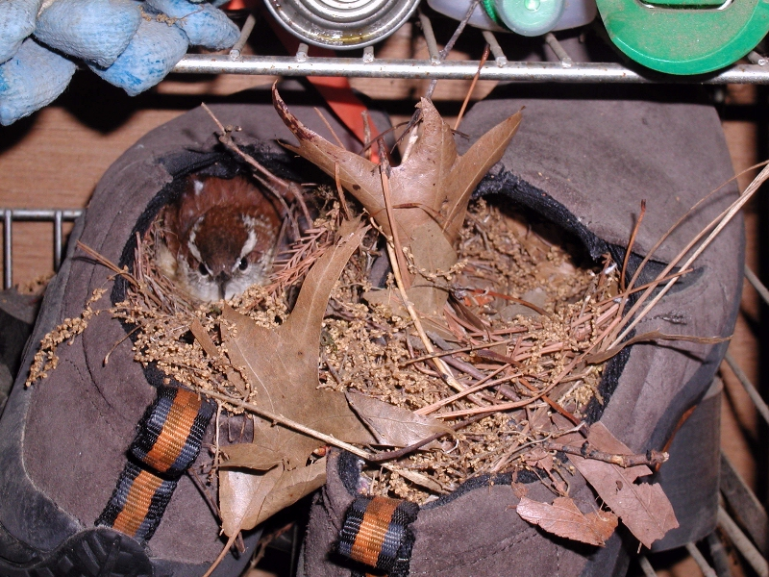
Carolina Wren
H. Eskin
D. Scheiman

Slide 35
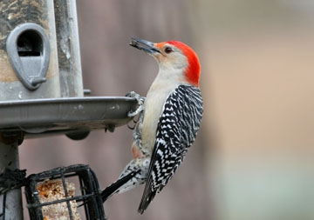
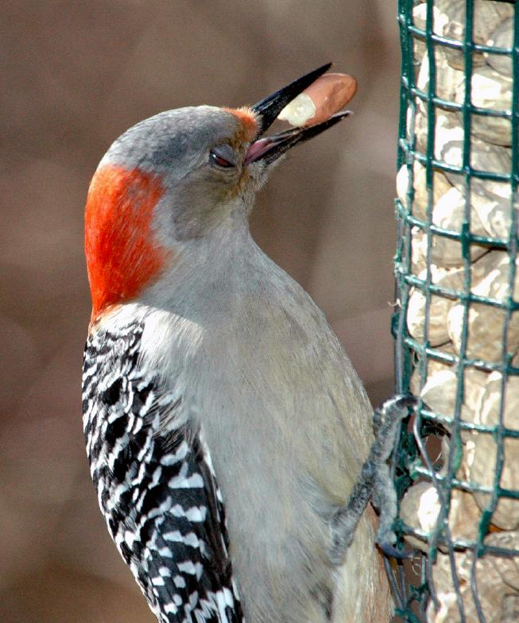
Red-bellied Woodpecker
D. McCauley
H. Eskin

Slide 36
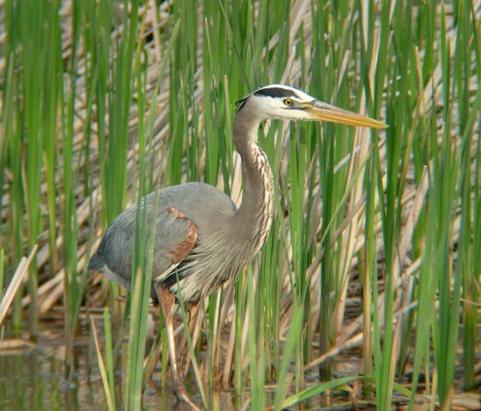
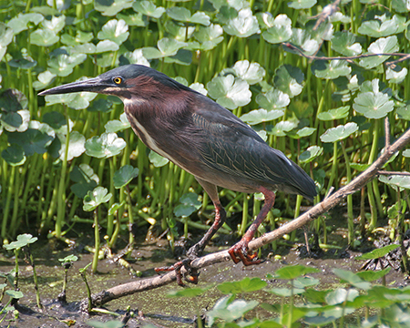
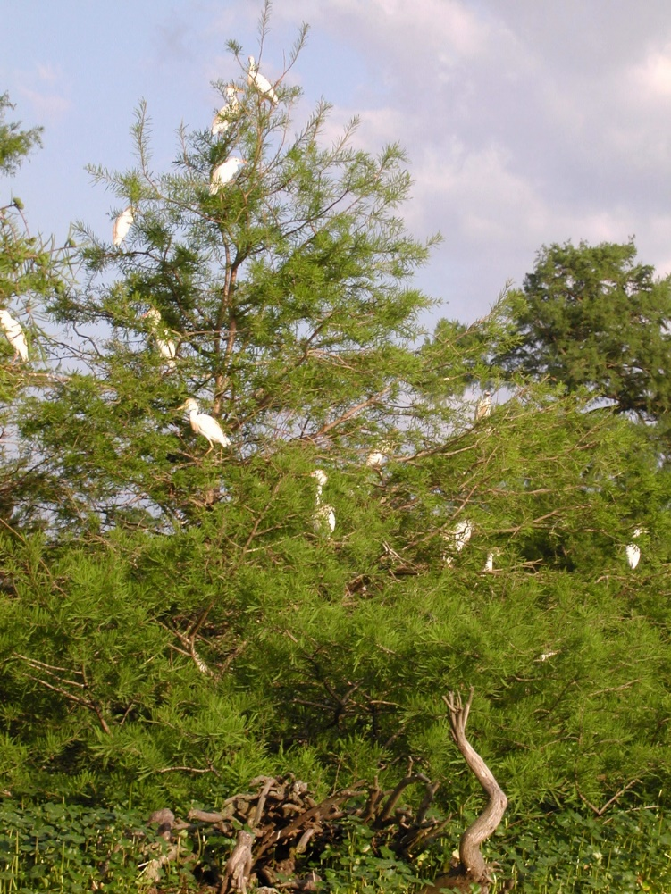
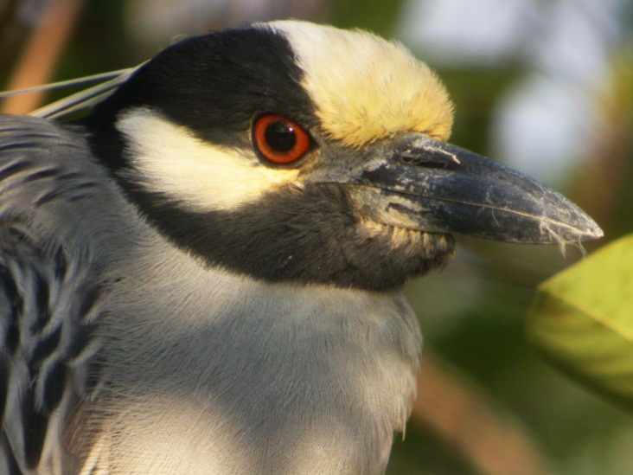
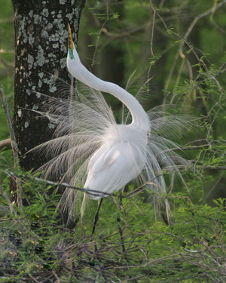
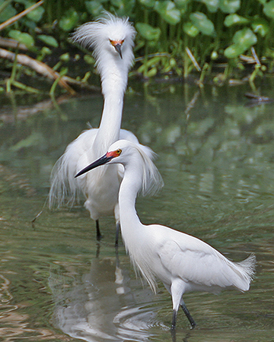
Herons & Egrets
R. Brady
R. Herron
Great Blue Heron
Green Heron
Yellow-crowned Night-Heron
N. Anich
D. Scheiman
Cattle Egrets
R. Herron
Great Egret
Snowy Egret
R. Herron

Slide 37
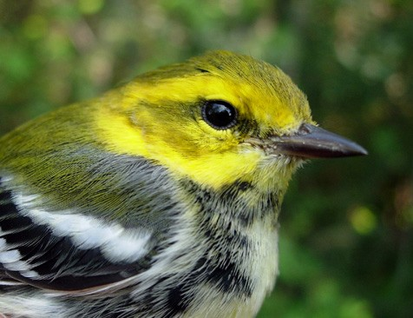
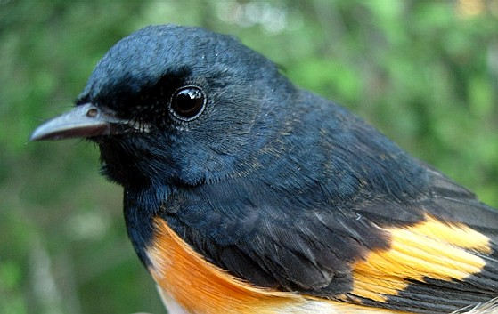
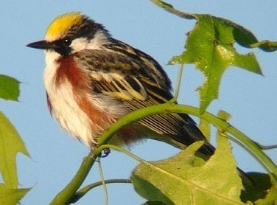
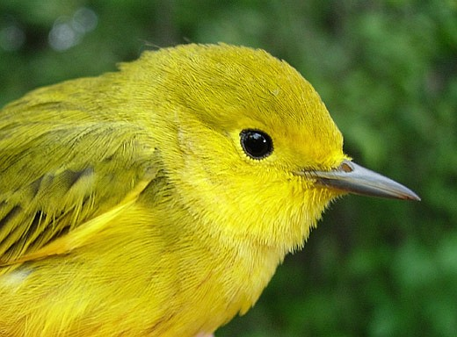
Warblers
Black-throated Green Warbler
American Redstart
Chestnut-sided Warbler
Yellow Warbler
R. Brady

Slide 38
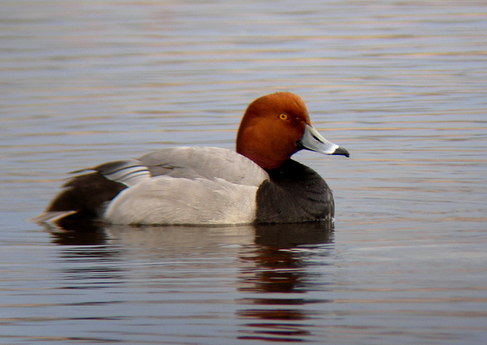
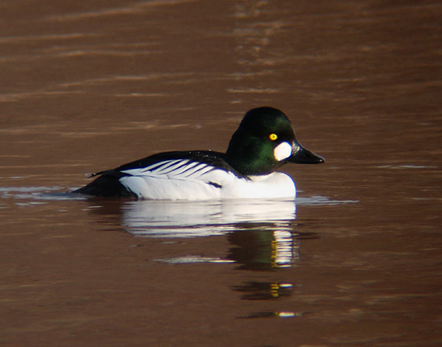
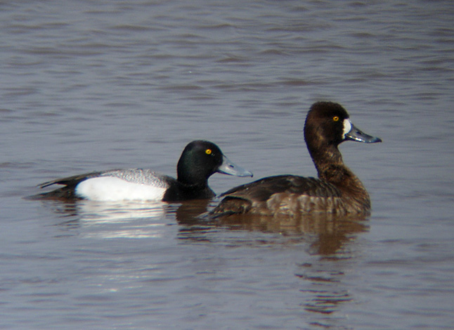
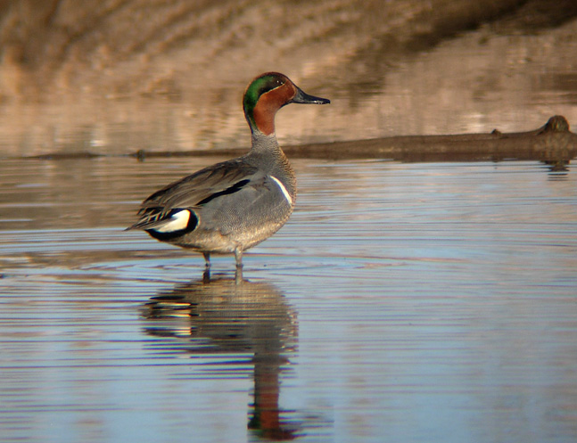
Waterfowl
Redhead
Common Goldeneye
Lesser Scaup
Blue-winged Teal
R. Brady
Green-winged Teal

Slide 39
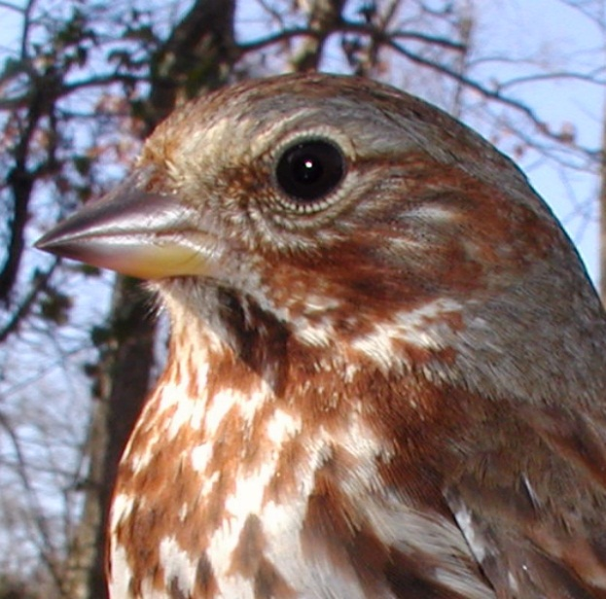
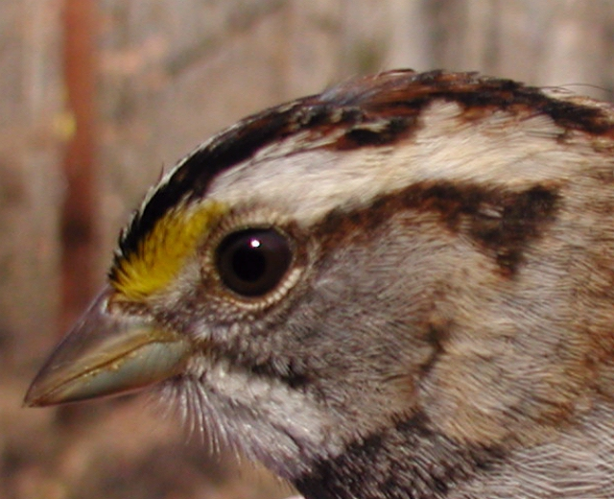
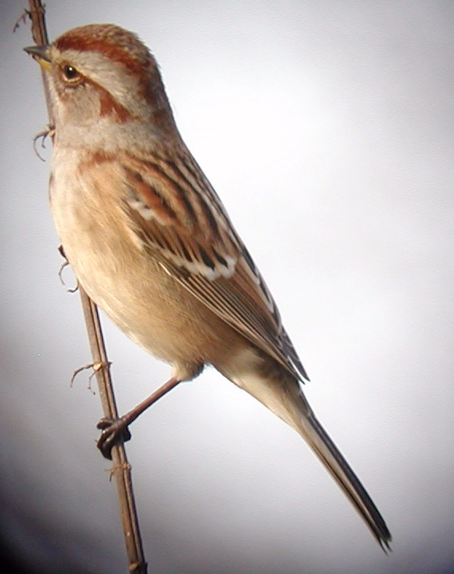
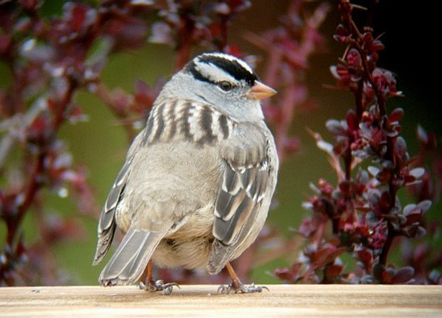
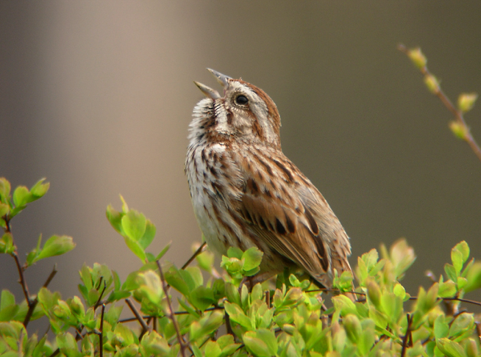
Sparrows
Fox Sparrow
D. Scheiman
White-throated Sparrow
American Tree Sparrow
White-crowned Sparrow
Song Sparrow
R. Brady

Slide 40
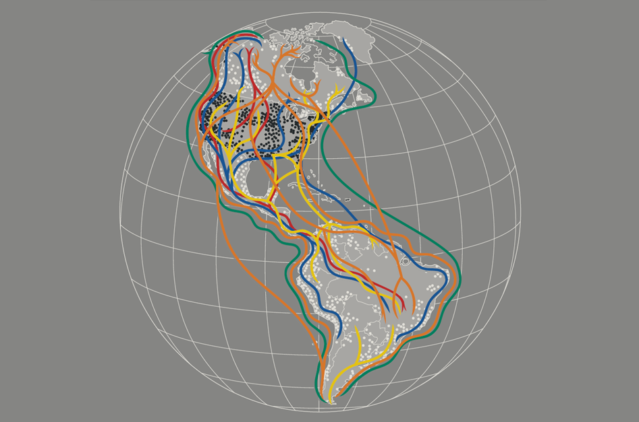

Slide 41
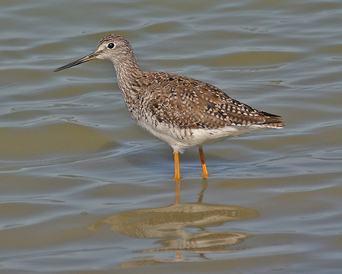
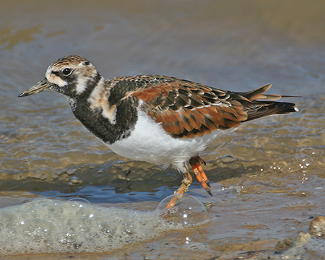
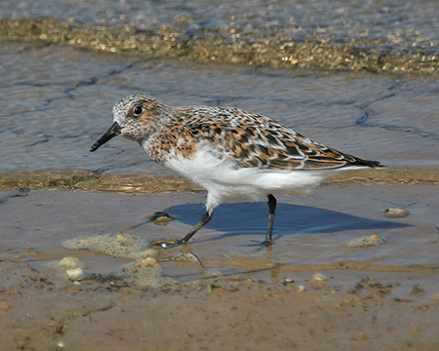
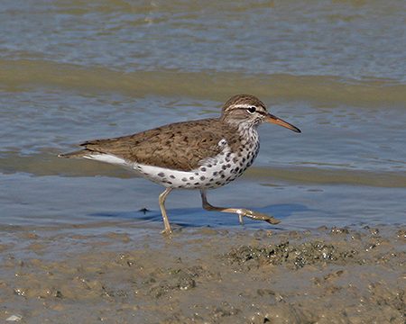
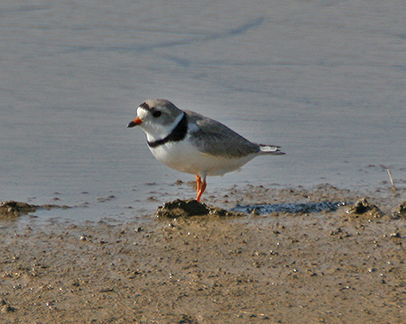
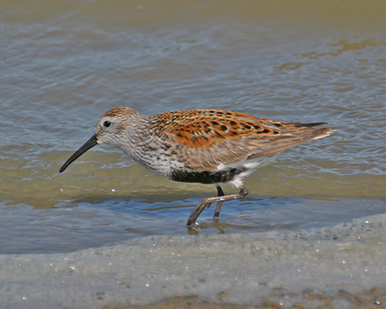
Shorebirds
Lesser Yellowlegs
Ruddy Turnstone
Western Sandpiper
Spotted Sandpiper
Semipalmated Plover
Dunlin
R. Herron

Slide 42
Rose-breasted Grosbeak
R. Herron
H. Eskin

Slide 43
Movement
Range expansion
Introduced
Natural

Slide 44
Introduced Species
Eurasian Collared-Dove
Rock Pigeon
R. Brady
R. Herron

Slide 45
Black-bellied Whistling-Duck
D. Arbour

Slide 46
Movement
Range expansion
Introduced
Natural
Range collapse
Extirpation
Extinction

Slide 47
Greater Prairie-Chicken

Slide 48
Extinct Species
Carolina Parakeet
Passenger Pigeon
Eskimo Curlew
John James Audubon

Slide 49
Movement
Range expansion
Introduced
Natural
Range collapse
Extirpation
Extinction
Random movements (Vagrant, Rare bird)
Off course
Wander
Weather

Slide 50
Say’s Phoebe
B. Harden

Slide 51
Broad-billed Hummingbird
C. Mills
Notes:
Found year round in Mexico. Migrates to breeding grounds in AZ/NM. Extralimital records in all seasons along Gulf Coast and CA. A few records further north, mostly breeding season. Now two in AR, one of the furthest wintering records for the species. First record Winter 2005/06 in White Hall. Second state record in Conway Winter 2008/09

Slide 52
Magnificent Frigatebird
D. Scheiman
Notes:
Hurricane Gustav, 2008, White Oak Lake

Slide 53
Brown Booby
C. Mills
Notes:
Lake Norrell, August 2012

Slide 54
Review
House Finch
Dynamic
Geography
Habitat
Season
Movement
R. Herron

Slide 55
Questions?
N. Anich

